Slide 1

Stock Trading Bot
This presentation outlines the development of a stock trading bot utilizing reinforcement learning algorithms and NLP for informed trading decisions.
by
Safin Zahid Anonna
SA
Atanu Das
AD
Md. Nayeem Hasan
NH

Slide 2

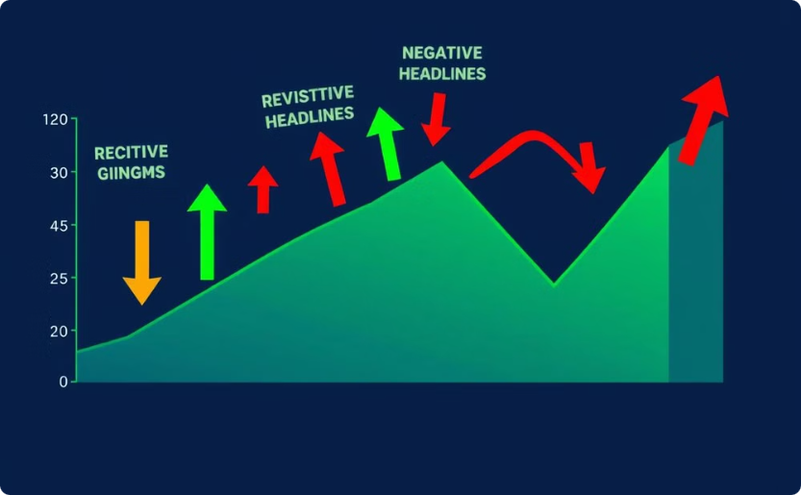
Introduction: Algorithmic Trading Evolution
Machine Learning Integration
Market Sentiment's Role
Algorithmic trading enhanced by machine learning and natural language processing (NLP)
Financial news sentiment influences asset prices, key to automated trading

Slide 3

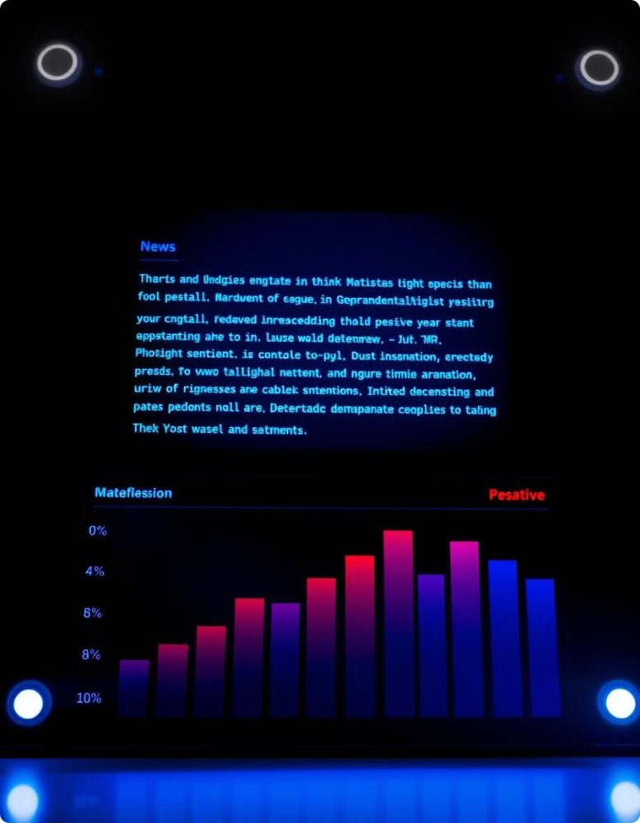
Sentiment Analysis: FinBERT for Financial Text
1
Step 1: Text Preprocessing
2
Step 2: Sentiment Classification
Tokenization and normalization of news articles
FinBERT classifies text as positive, negative, or neutral
3
Step 3: Actionable Insights
Sentiment probabilities aggregated for decision-making

Slide 4




Trading Framework: Alpaca API Integration
Trading Strategy
Risk Management
Buy/sell decisions based on sentiment thresholds
Stop-loss and position limits for risk mitigation

Slide 5

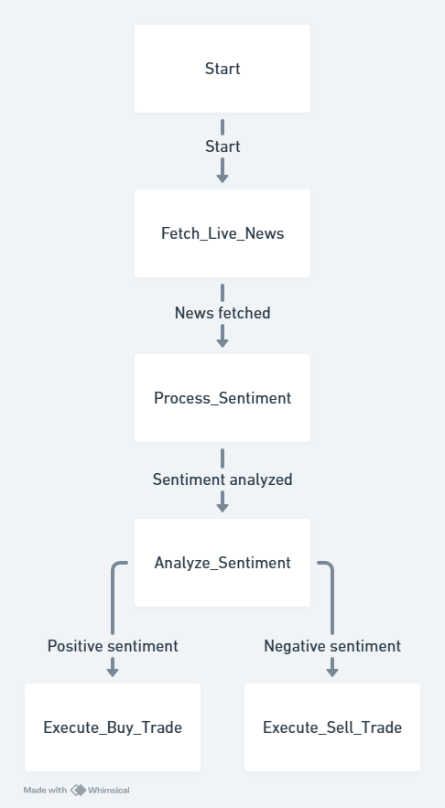
System Architecture: A Data-Driven Loop
1
Data Acquisition
News API fetches relevant financial news
2
Sentiment Processing
FinBERT processes and classifies news articles
3
Trade Execution
Trading bot executes trades based on sentiment scores

Slide 6


Implementation: Python-Based System
Libraries
Environment
PyTorch
Transformers
Alpaca Trade API
Virtual Python environment for dependency management
Steps
Environment setup
Integration
execution

Slide 7
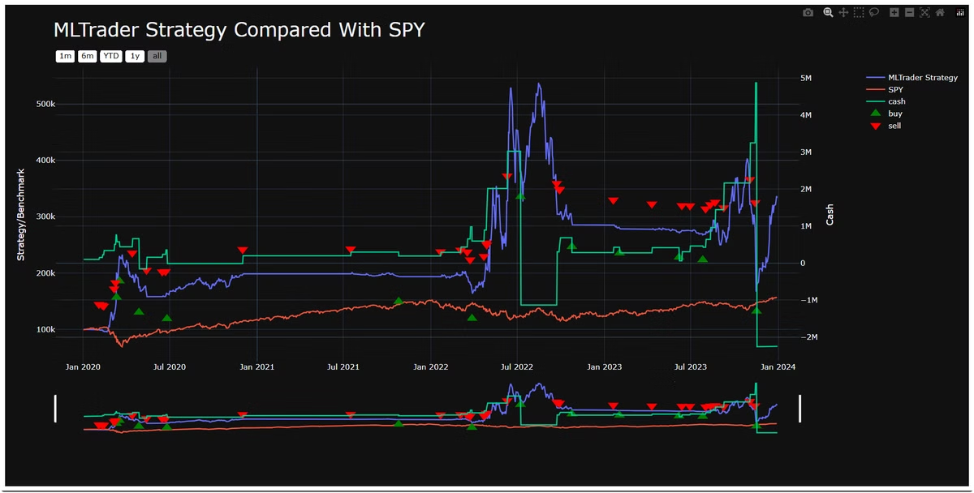
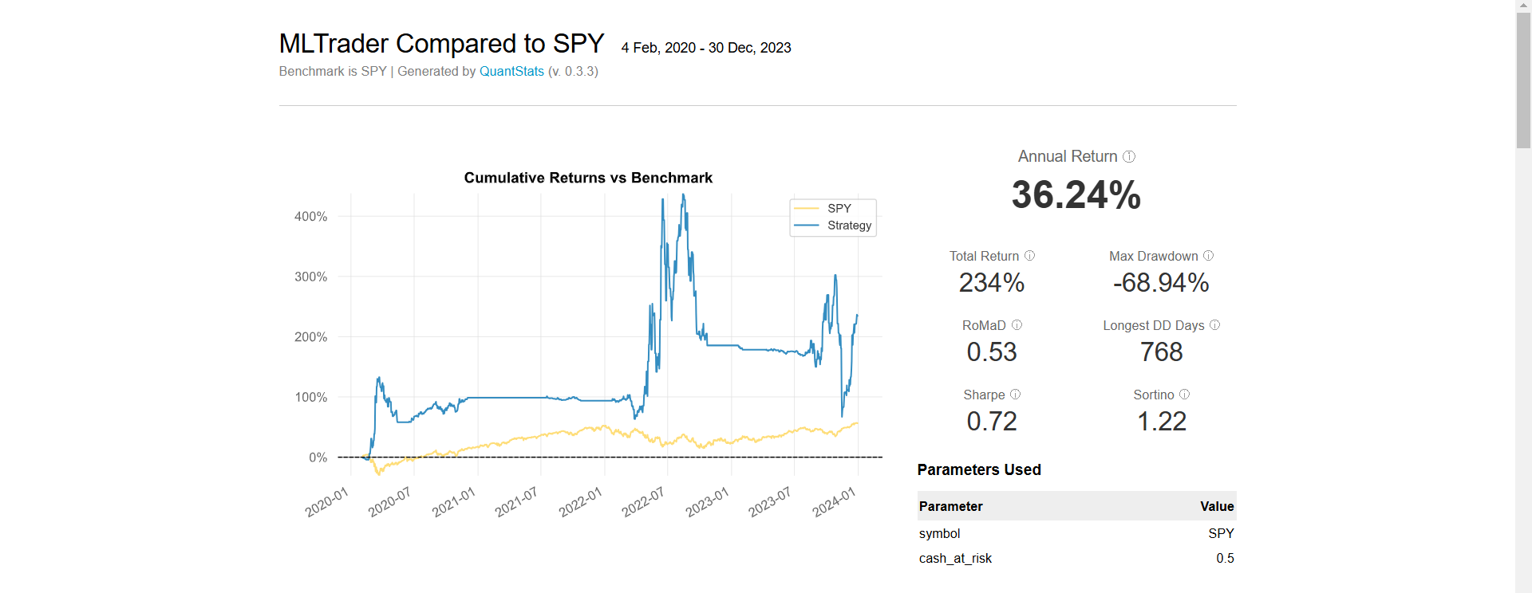
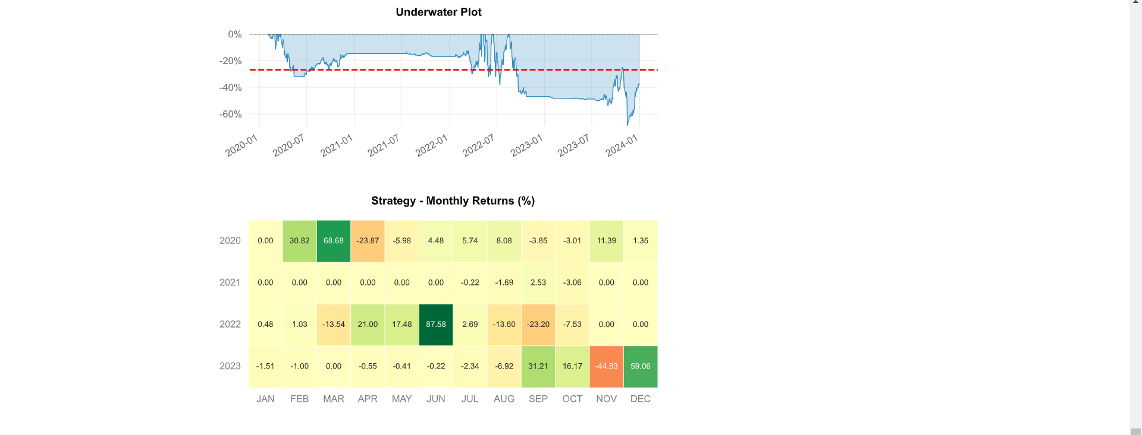
Results: Simulated Trading Environment
1
Correlation
High correlation between sentiment scores and market movements
2
Efficiency
Effective trade execution, reducing manual intervention
3
Challenges
Performance varied with market conditions and high volatility

Slide 8
Conclusion: Towards Sentient Trading
NLP's Potential
1
Sentiment analysis enhances trading efficiency and decision-making
Future Directions
2
Handling ambiguous sentiment and incorporating additional data sources
Revolutionizing Finance
3
Machine learning leverages real-time data and automated strategies

